Slide 1

Systems Analysis and Design
Week 4-5-6-7 Extra Resource - 1
Khayyam H. MASIYEV
BHOS☺
Information Security Division
Senior Lecturer
khayyam.masiyev@bhos.edu.az

Slide 2
Topics covered
Software Processes
Plan-driven and Agile Processes
Model (modeling) intro / System Modeling (intro)
System perspectives -> Context models -> Interaction models -> Structural models -> Behavioral models
UML
Ex. For Home
Practices – Final Project
As always this lecture slide slso will send to all via email!!!

Slide 3
The software process
A process means “a particular method of doing something, generally involving a number of steps or operations.”
In software engineering, the phrase software process refers (muraciet) to the method of developing software.
A software process can be called a framework of tasks required to build high-quality software.

Slide 4
Processes and Models
Software process specifies how one (you ;) can manage and plan a software development project taking constraints (mehdudiyyet) and boundaries (serhed) into consideration.

Slide 5
A software process, specifies a method of developing software.
A software project, on the other hand, is a development project in which a software process is used.

Slide 6
The software process
A software process is the set of activities and associated results that produce a software product.
There are four fundamental process activities, which are common to all software processes. These activities are:
Software Specification – defining what the system should do;
Software Development (Design and implementation) – defining the organization of the system and implementing the system;
Software Validation – checking that it does what the customer wants;
Software Evolution – changing the system in response to changing customer needs.
Different organizations may use different processes to produce the same type of product.

Slide 7
Plan-driven and agile processes
Plan-driven processes are processes where all of the process activities are planned in advance and progress is measured against this plan.
In agile processes, it is easier to change the process to reflect changing customer requirements.
In practice, most practical processes include elements of both plan-driven and agile approaches.
There are no right or wrong software processes.

Slide 8
Software process models
The waterfall model
Plan-driven model. Separate and distinct (ferqli) phases of specification and development. This takes the above activities and represents them as separate process phases such as requirements specification, software design, implementation, testing and so on. After each stage is defined it is ‘signed off’ and development goes on to the following stage.
Incremental development
Specification, development and validation are interleaved (mix). May be plan-driven or agile.
System Assembly from Reusable Components (Integration and configuration)
The system is assembled from existing configurable components. May be plan-driven or agile.
This technique assumes that parts of the system already exist. The system development process focuses on integrating these parts rather than developing them from scratch.
In practice, most large systems are developed using a process that incorporates elements from all of these models.

Slide 9
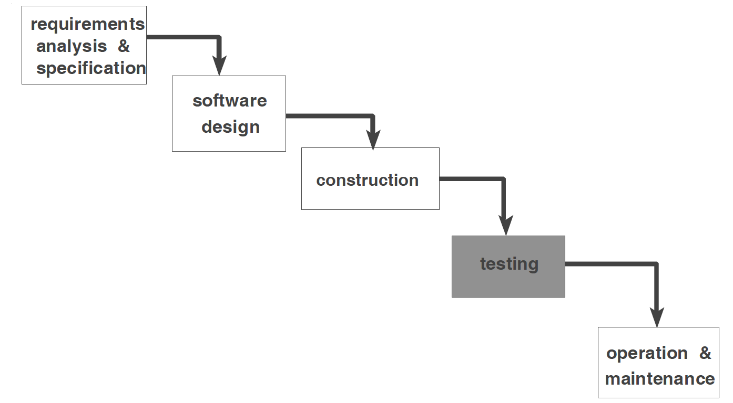
The waterfall model

Slide 10
Waterfall model phases
Software Requirements Analysis: The requirements gathering process is intensified and focused specifically on software. In order to understand the nature of programs which are to be built, the system analyst or engineer must understand the software information domain in addition with the required behavior, function, performance and interface. These requirements for both the software and the system are documented and reviewed in discussion with clients or customers.
Design: Software design is actually a multi-step process that focuses on four distinct attributes of a program: data structure, software architecture, interface representations, and procedural (algorithmic) detail. The design process translates requirements into a representation of the software that can be assessed for quality before coding begins. Like requirements, the design is documented and becomes part of the software configuration.
Code Generation: The design must be translated into a machine-readable form.
Testing: Once code has been generated, program testing begins. The testing process focuses on the logical internals of the software, ensuring that all statements have been tested, and on the functional externals; that is, conducting tests to uncover errors and ensure that defined input will produce actual results that agree with required results.
Support

Slide 11
Waterfall model problems
Inflexible partitioning of the project into distinct stages makes it difficult to respond to changing customer requirements.
Therefore, this model is only appropriate when the requirements are well-understood and changes will be fairly limited during the design process.
Few business systems have stable requirements.

Slide 12
Incremental development
Incremental software development, which is a fundamental part of agile approaches, is better than a waterfall approach for most business, e-commerce, and personal systems.
Incremental development reflects the way that we solve problems.

Slide 13
Incremental development
Each increment or version of the system incorporates some of the functionality that is needed by the customer.
Generally, the early increments of the system include the most important or most urgently required functionality.
This means that the customer can evaluate the system at a relatively early stage in the development to see if it delivers what is required.
If not, then only the current increment has to be changed and, possibly, new functionality defined for later increments.

Slide 14
Incremental development

Slide 15
Incremental development & delivery

Slide 16
Incremental development benefits
The cost of accommodating changing customer requirements is reduced.
The amount of analysis and documentation that has to be redone is much less than is required with the waterfall model.
It is easier to get customer feedback on the development work that has been done.
Customers can comment on demonstrations of the software and see how much has been implemented.
More rapid delivery and deployment of useful software to the customer is possible.
Customers are able to use and gain value from the software earlier than is possible with a waterfall process.

Slide 17
Incremental development problems
The process is not visible.
Managers need regular deliverables to measure progress. If systems are developed quickly, it is not cost-effective to produce documents that reflect every version of the system.
System structure tends to degrade as new increments are added.
Unless time and money is spent on refactoring to improve the software, regular change tends to corrupt its structure. Incorporating further software changes becomes increasingly difficult and costly.

Slide 18
Reuse-oriented software engineering
In the majority of software projects, there is some software reuse. This often happens informally when people working on the project know of designs or code that are similar to what is required. They look for these, modify them as needed, and incorporate them into their system.

Slide 19
Reuse-oriented software engineering

Slide 20
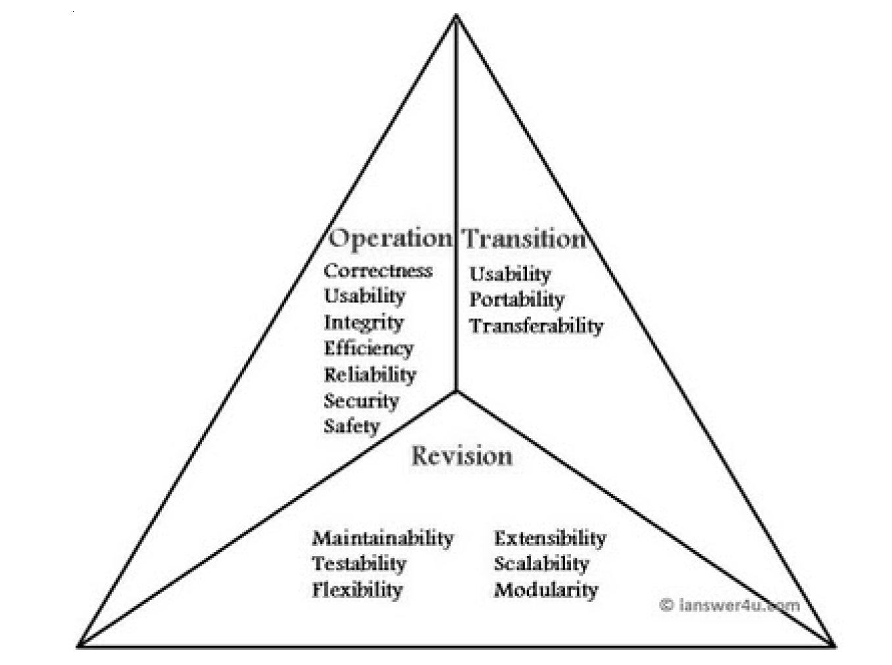
Software Quality Triangle
The three characteristics of good application software are:
1. Operational Characteristics
2. Transition (kecid) Characteristic
3. Revision (tekrar baxis) Characteristics

Slide 21
Model (modeling) intro / System Modeling (intro)

Slide 22
Defining “model”
Modeling helps the engineer to understand the functionality of the system
Models are used for communication among stakeholders
Different models present the system from different perspectives
Model: is a representation of some aspect of the system being built.
We regularly use models in everyday life. For example, maps and plans are models of the layout of the roads, rivers, buildings or other features of our physical environment.

Slide 23
Systems, Models, and Views
Flightsimulator
Blueprints
Airplane
Electrical
Wiring
A model is an abstraction describing system or a subset of a system
A view depicts (demonstrate) selected aspects of a model
Scale Model

Slide 24
The purpose of models
Models help the analyst clarify and simplify the design (means simplify complex aspects of systems)
Models assist in the communication between system and developers and foster understanding

Slide 25
Why model a software?
Software is getting larger, not smaller
OS min. 5.0 ~ 40 million lines of code
A single programmer cannot manage this amount of code in its entirety.
Code is often not directly understandable by developers who did not participate in the development stage
We need simpler representations for complex systems
Modeling is a mean for dealing with complexity

Slide 26
So -> Why to use Models?
Models are used
during the requirements engineering process to help derive (extract) the requirements for a system,
during the design process to describe the system to engineers implementing the system
and after implementation to document the system’s structure and operation.
You may develop models of both the existing system and the system to be developed:

Slide 27
System modeling
System modeling is the process of developing abstract models of a system (Abstract descriptions of systems whose requirements are being analysed)
System modelling helps the analyst to understand the functionality of the system and models are used to communicate with customers. (HOW?, see next slide )
System modeling representing a system using some kind of graphical notation (based on notations in the Unified Modeling Language (UML)). Why, because of to simplify understanding of a system.

Slide 28
Existing and planned (or developed) system models
Models of the existing system are used during requirements engineering (Remember SDLC). They help clarify what the existing system does and can be used as a basis for discussing its strengths and weaknesses. These then lead to requirements for the new system.
Models of the new system are used during requirements engineering to help explain the proposed requirements to other system stakeholders. Engineers use these models to discuss design proposals and to document the system for implementation.

Slide 29
Important aspect of a system model
is that it leaves out detail.
What means that, A model is an abstraction of the system being studied rather than an alternative representation of that system. (abstraction not means of alternative representation)
For example, in the very unlikely event of our main course book being serialized in a newspaper, the presentation there would be an abstraction of the book’s key points. If it were translated from English into Italian, this would be an alternative representation.

Slide 30
System perspectives
You may develop different models to represent the system from different perspectives. For example:
An external perspective, where you model the context (situation) or environment of the system. (as using Context model)
An interaction perspective, where you model the interactions between a system and its environment, or between the components of a system. (as using Interaction model)
A structural perspective, where you model the organization of a system or the structure of the data that is processed by the system. (as using structural model)
A behavioral perspective, where you model the dynamic behavior of the system and how it responds to events. (as using behavioral model)

Slide 31
UML (Unified Modeling Language) diagram types *
The UML is universally accepted as the standard approach for developing models of software systems (as you know from SAD course).
The UML has many diagram types and so supports the creation of many different types of system model.
Activity diagrams, which show the activities involved in a process or in data processing. (we will use it in an example in Context Modeling section)
Use case diagrams, which show the interactions between a system and its environment. (we will use it in an example in Interaction Modeling section)
Sequence diagrams, which show interactions between actors and the system and between system components. (we will use it in an example in Interaction Modeling section)
Class diagrams, which show the object classes in the system and the associations between these classes. (we will use it in an example in Structural Modeling section)
State diagrams, which show how the system reacts to internal and external events. (we will use it in an example in Behavioral Modeling section)
* Which you already learned from SAD course..

Slide 32
Advantage of -> Use (using) of graphical models
There are three ways in which graphical models are used:
As a means of facilitating (simplify) discussion about an existing or proposed system
As a way of documenting an existing system
As a detailed system description that can be used to generate a system implementation

Slide 33
Context models

Slide 34
Context (condition) models
Context models are used to illustrate the operational context of a system - they show what lies outside the system boundaries. (remember prev. slide “System perspectives”)

Slide 35
System boundaries
System boundaries are established to define what is inside and what is outside the system.
They show other systems that are used or depend on the system being developed.

Slide 36
The context of the Mentcare system (remember example from our main book)
simple context model that shows the patient information system and the other systems in its environment (we can see context and the dependencies that a system has on its environment )

Slide 37
Process perspective
Context models simply show the other systems in the environment, (but) not how the system being developed is used in that environment. Also do not show the types of relationships between the systems in the environment.
Process models reveal how the system being developed is used in broader business processes.
You can use UML activity diagrams (see next slide) to define business process models. (if you remember) Activity diagrams are intended to show the activities (rectangles with round corners in next slide) that make up a system process and the flow of control from one activity to another.

Slide 38
Process model of involuntary detention
is a model of an important system process that shows the processes in which the Medical-PMS is used.
One of the functions of the Medical-PMS is to ensure that such safeguards are implemented.

Slide 39
Interaction models
(remember prev. slide “System perspectives”)

Slide 40
Interaction models (let’s see why it is important)
Modeling user interaction (which involves user inputs and outputs) is important as it helps to identify user requirements.
Modeling system-to-system interaction highlights the communication problems that may arise.
Modeling component interaction helps us understand if a proposed system structure is likely to deliver the required system performance and dependability.
Use case diagrams and sequence diagrams may be used (see next slides) for interaction modeling.

Slide 41
Use case modeling
Use case modeling, which is mostly used to model interactions between a system and external actors (users or other systems).
Actors in a use case may be people or other systems.

Slide 42
Transfer-data (example of the transaction and data is transferred to the patient record system) use case
A use case in the (our example) Mentcare system
a use case is shown as an ellipse with the actors
Notice that there are two actors in this use case: the operator who is transferring the data and the patient record system.

Slide 43
Use case diagrams give a fairly simple overview of an interaction so you have to provide more detail to understand what is involved.
This detail can either be a simple textual description, a structured description in a table (see next slide)

Slide 44
Tabular description of the ‘Transfer data’ use-case (Tabular view of our use case example)
Medical-PMS: Transfer data
Actors | Medical receptionist, patient records system (PRS)
Description | A receptionist may transfer data from the Mentcare system to a general patient record database that is maintained by a health authority. The information transferred may either be updated personal information (address, phone number, etc.) or a summary of the patient’s diagnosis and treatment.
Data | Patient’s personal information, treatment summary
Stimulus | User command issued by medical receptionist
Response | Confirmation that PRS has been updated
Comments | The receptionist must have appropriate security permissions to access the patient information and the PRS.

Slide 45
Use cases in the Mentcare system involving the role ‘Medical Receptionist’
you may develop several diagrams, each of which shows related use cases
^{Like ..}

Slide 46
Sequence diagrams
Sequence diagrams, which are used to model interactions between system components, although external agents may also be included.
Sequence diagrams are part of the UML and are used to model the interactions between the actors and the objects within a system.
A sequence diagram shows the sequence of interactions that take place during a particular use case

Slide 47
Sequence diagram for View patient information

Slide 48
Sequence diagram for Transfer Data

Slide 49
You can read this diagram as follows:
1. The receptionist logs on to the PRS. (patient record system)
2. There are two options available. These allow the direct transfer of updated patient information to the PRS and the transfer of summary health data from the MHC-PMS to the PRS.
3. In each case, the receptionist’s permissions are checked using the authorization system.
4. Personal information may be transferred directly from the user interface object to the PRS. Alternatively, a summary record may be created from the database and that record is then transferred.
5. On completion of the transfer, the PRS issues a status message and the user logs off.

Slide 50
Structural models
(remember prev. slide “System perspectives”)

Slide 51
Structural models
Structural models of software display the organization of a system in terms of the components that make up that system and their relationships.
You create structural models of a system when you are discussing and designing the system architecture.
Class diagrams may be used (see next slides) for structural modeling.

Slide 52
Class diagrams
Class diagrams are used when developing an object-oriented system model to show the classes in a system and the associations between these classes (you are familiar for this terminology from OOP and SAD cources).
An object class can be thought of as a general definition of one kind of system object.
An association is a link between classes that indicates that there is some relationship between these classes.
When you are developing models during the early stages of the software engineering process, objects represent something in the real world, such as a patient, a prescription, doctor, etc.

Slide 53
UML classes and association
is a simple class diagram showing two classes: Patient and Patient Record with an association between them
with a 1, meaning that there is a 1:1 relationship between objects of these classes. That is, each patient has exactly one record and each record maintains information about exactly one patient.

Slide 54
Classes and associations in the MHC-PMS
to show that objects of class Patient are also involved in relationships with a number of other classes

Slide 55
Generalization
Generalization is an everyday technique that we use to manage complexity.
Rather than learn the detailed characteristics of every entity that we experience, we place these entities in more general classes (animals, cars, houses, etc.) and learn the characteristics of these classes.
In object-oriented languages, such as Java, generalization is implemented using the class inheritance mechanisms built into the language (you learned this concept in OOP course).

Slide 56
A generalization hierarchy
This shows that general practitioners and hospital doctors can be generalized as doctors

Slide 57
Behavioral models
(remember prev. slide “System perspectives”)

Slide 58
Behavioral models
Behavioral models are models of the dynamic behavior of a system as it is executing. They show what happens or what is supposed to happen when a system responds to a stimulus from its environment.
You can think of these stimuli as being of two types:
Data Some data arrives that has to be processed by the system.
Events Some event happens that triggers system processing. Events may have associated data

Slide 59
Data-driven modeling
Data-driven models show the sequence of actions involved in processing input data and generating an associated output.
They are particularly useful during the analysis of requirements as they can be used to show end-to-end processing in a system.

Slide 60
Order processing (An activity model of the insulin pump’s operation)

Slide 61
An activity model of the insulin pump’s operation

Slide 62
FURTHER READING
Requirements Analysis and System Design. This book focuses on information systems analysis and discusses how different UML models can be used in the analysis process. (L. Maciaszek, Addison-Wesley, 2001.)
MDA Distilled: Principles of Model-driven Architecture .This is a concise and accessible introduction to the MDA method. It is written by enthusiasts so the book says very little about possible problems with this approach. (S. J. Mellor, K. Scott and D. Weise, Addison-Wesley, 2004.)
Using UML: Software Engineering with Objects and Components, 2nd ed. A short, readable introduction to the use of the UML in system specification and design. This book is excellent for learning and understanding the UML, although it is not a full description of the notation. (P. Stevens with R. Pooley, Addison-Wesley, 2006.)

Slide 63
EXERCISES for Home
EXERCISES – needs to prepare at Home and needs to be ready for discussion in next lecture (practice) day (16.11.2015).
Deadline is Sunday (15.11.2015), 17:00 PM. Needs to send as .doc file via email till deadline date and time. Late emails will not be accepted!!!
Note: Final MDIA results will be from evaluation of these ex.s (Currently you can see your intital MDIA result. Final result will be added in Final Examination week.)

Slide 64
EXERCISES (Students Presentations; Accepted HWs)
6.1. Explain why it is important to model the context of a system that is being developed. Give two examples of possible errors that could arise if software engineers do not understand the system context.
6.2. How might you use a model of a system that already exists? Explain why it is not always necessary for such a system model to be complete and correct. Would the same be true if you were developing a model of a new system?
6.3. For the MHC-PMS, propose a set of use cases that illustrates the interactions between a doctor, who sees patients and prescribes medicine and treatments, and the MHC-PMS.
6.4. Develop a sequence diagram showing the interactions involved when a student registers for a course in a university. Courses may have limited enrollment, so the registration process must include checks that places are available. Assume that the student accesses an electronic course catalog to find out about available courses.
6.5. Draw state diagrams of the control software for:
An automatic washing machine that has different programs for different types of
clothes.
The software for a DVD player.
A telephone answering system that records incoming messages and displays the number of accepted messages on an LED. The system should allow the telephone customer to dial in from any location, type a sequence of numbers (identified as tones), and play any recorded messages.
Accepted HWs Students: Ulduz B., Elnur R., Fatullokhon Y., Mahammed V., Elmi A., Tarlan B., Kamal Z.

Slide 65
6.1. Explain why it is important to model the context of a system that is being developed. Give two examples of possible errors that could arise if software engineers do not understand the system context.
Answer:
Because context models show the environment that includes several other automated systems. These models will help in getting a clear view of the system to be developed and several other systems involved. To model the context of a system,
Identify the boundaries of the system by deciding which behaviors are part of it and which are performed by external entities. This defines the subject.
Identify the actors that surround the system by considering which groups require help from the system to perform their tasks, which groups are needed to execute the system's functions, which groups interact with external hardware or other software systems, and which groups perform secondary functions for administration and maintenance.
Organize actors that are similar to one another in a generalization-specialization hierarchy.
Where it aids understandability, provide a stereotype for each such actor.
Examples of possible errors:
The software engineers may miss some functionality to be included which require coordinating with automated systems.
The system design and development may be deviated from the actual functionality as some requirements may not be known properly?

Slide 66
6.2. How might you use a model of a system that already exists? Explain why it is not always necessary for such a system model to be complete and correct. Would the same be true if you were developing a model of a new system?
Answer:
use a model of a system that already exists for the following reasons:
1. To understand and document the architecture and operation of the existing system.
2. To act as the focus of discussion about possible changes to that system.
3. To inform the re-implementation of the system.
You do not need a complete model unless the intention is to completely document the operation of the existing system. The aim of the model in such cases is usually to help you work on parts of the system so only these need to be modelled.
Furthermore, if the model is used as a discussion focus, you are unlikely to be interested in details and so can ignore parts of the system in the model. This is true, in general, for models of new systems unless a model-based approach to development is taking place in which case a complete model is required. The other circumstances where you may need a complete model is when there is a contractual requirement for such a model to be produced as part of the system documentation.

Slide 67
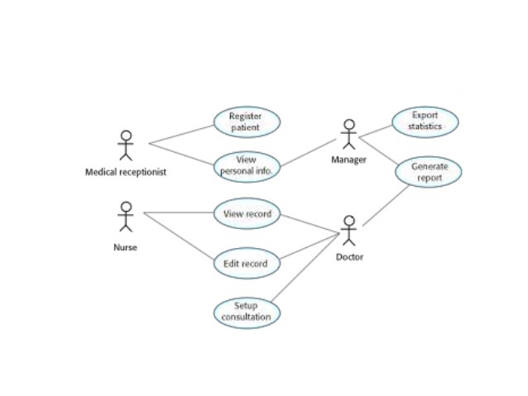
6.3. For the MHC-PMS, propose a set of use cases that illustrates the interactions between a doctor, who sees patients and prescribes medicine and treatments, and the MHC-PMS.

Slide 68
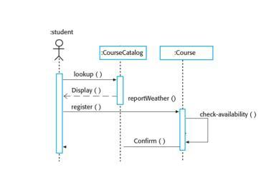
6.4. Develop a sequence diagram showing the interactions involved when a student registers for a course in a university. Courses may have limited enrollment, so the registration process must include checks that places are available. Assume that the student accesses an electronic course catalog to find out about available courses.

Slide 69
6.5. Draw state diagrams of the control software for: 1. An automatic washing machine that has different programs for different types of clothes. 2. The software for a DVD player. 3. A telephone answering system that records incoming messages and displays the number of accepted messages on an LED. The system should allow the telephone customer to dial in from any location, type a sequence of numbers (identified as tones), and play any recorded messages.

Slide 70
6.5.1. An automatic washing machine that has different programs for different types of clothes.
How does a Washing Machine Works?
On / Off button. Start button (No stop button.)
Feedback is given on the current stage (soaking, rinsing, draining, drying)
Three plans:
Regular
Delicate (no soaking)
Super delicate (no soaking, no drying)
Off can be clicked only before starting, or after finishing

Slide 71
Washing Machine

Slide 72
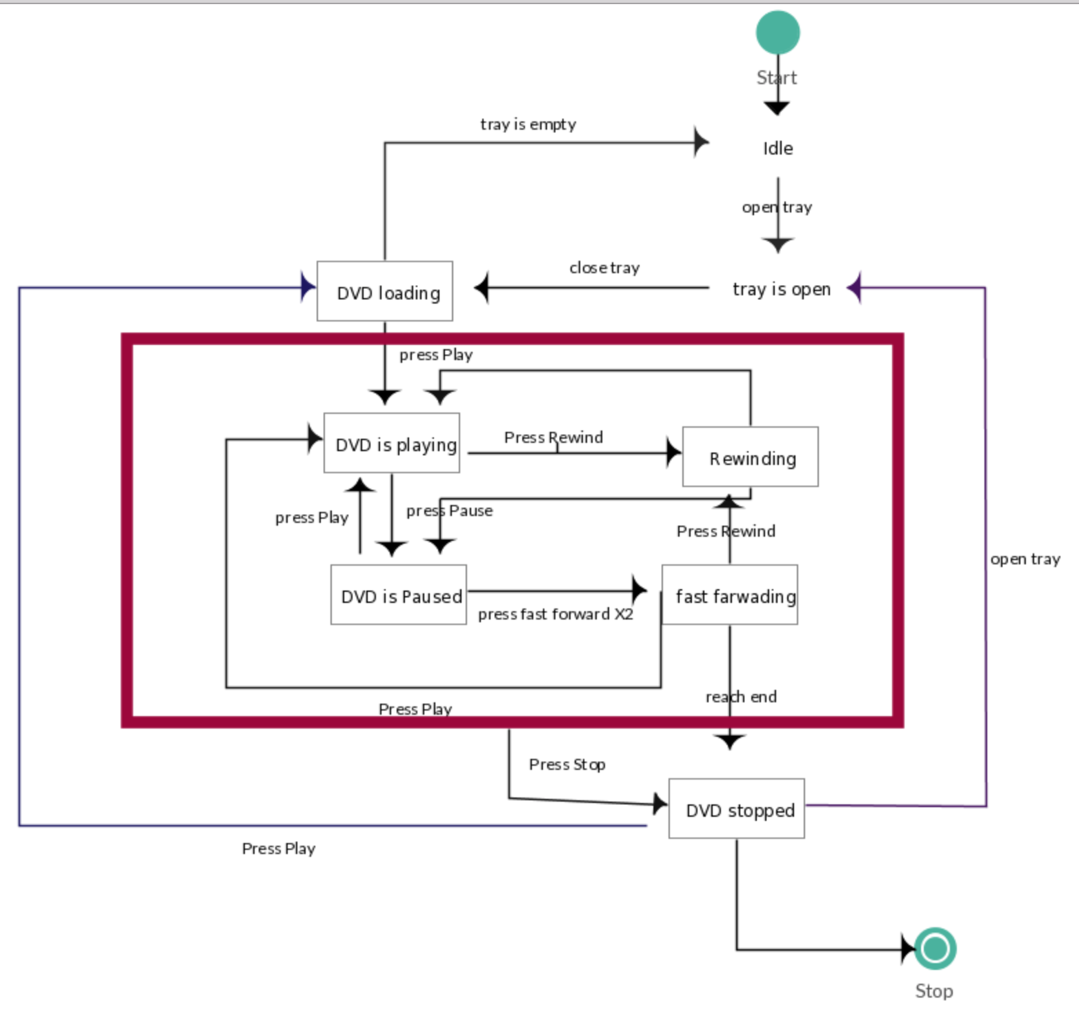
6.5.2. The software for a DVD player.

Slide 73
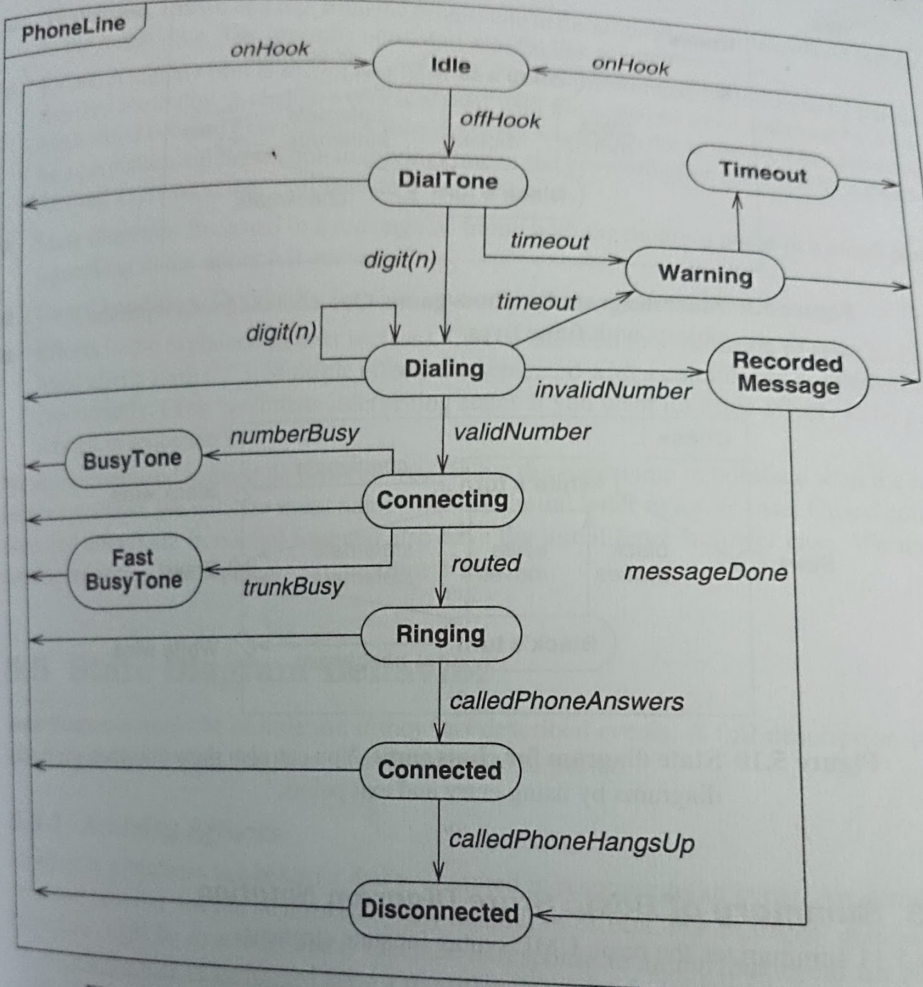
6.5.3.A telephone answering system that records incoming messages and displays the number of accepted messages on an LED. The system should allow the telephone customer to dial in from any location, type a sequence of numbers (identified as tones), and play any recorded messages.

